Slide 1
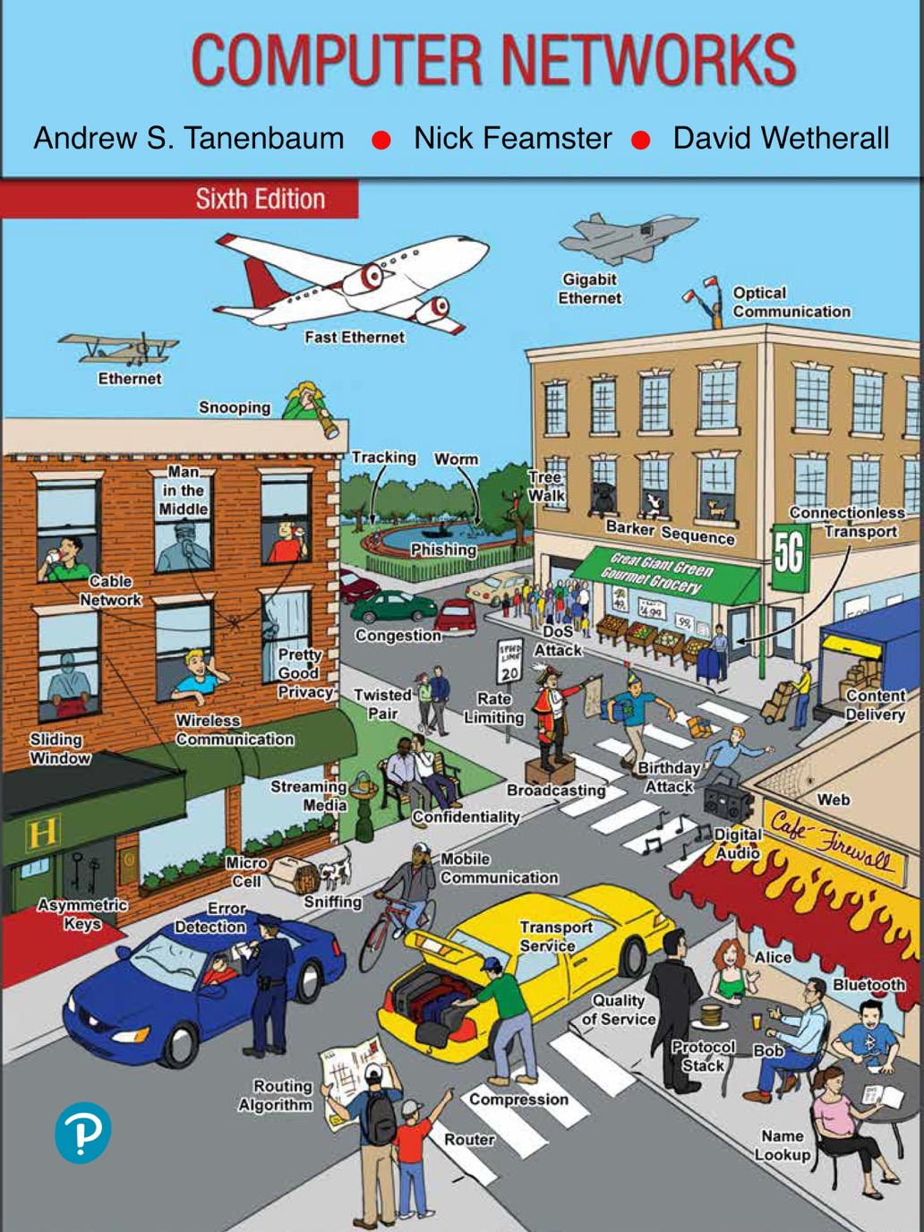
Chapter 2
The Physical Layer

Slide 2
Guided Transmission Media
Guided transmission media
Persistent storage
Twisted pairs
Coaxial cable
Power lines
Fiber optics

Slide 3
Persistent Storage
Consists of magnetic or solid-state storage
Common way to transport data
Write to persistent storage
Physically transport the tape or disks to the destination machine
Read data back again
Cost effective for applications where a high data rate or cost per bit transported is the key factor
Never underestimate the bandwidth of a station wagon full of tapes hurtling down the highway

Slide 4
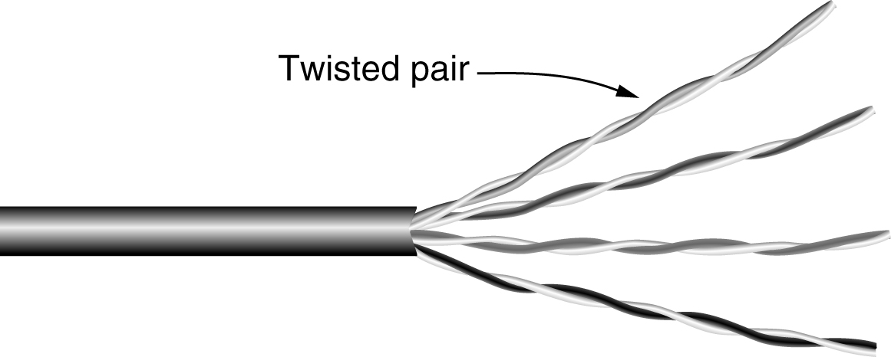
Twisted Pairs
A category 5e twisted pair consists of two insulated wires gently twisted together. Four such pairs are typically grouped in a plastic sheath to protect the wires and keep them together.

Slide 5
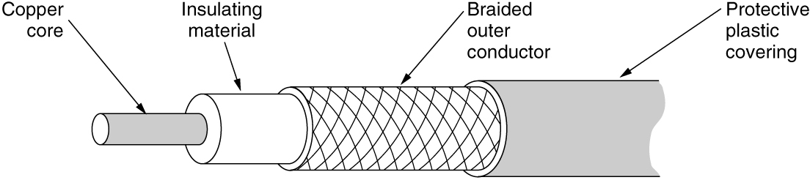
Coaxial Cable
A coaxial cable consists of a stiff copper wire as the core, surrounded by an insulating material. The insulator is encased by a cylindrical conductor, often as a closely woven braided mesh. The outer conductor is covered in a protective plastic sheath.

Slide 6
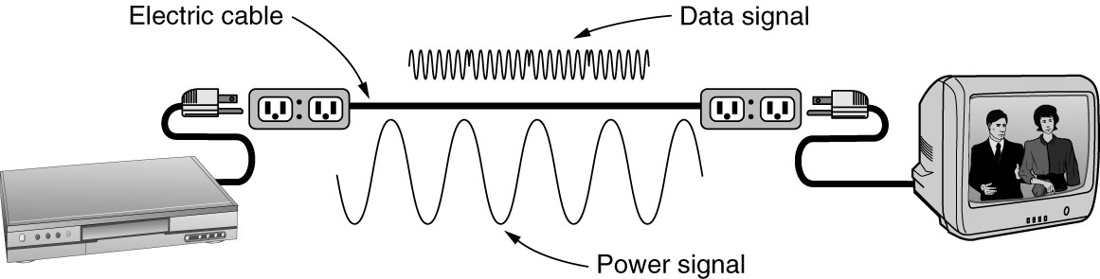
Power Lines
Using power lines for networking is simple. In this case, a TV and a receiver are plugged into the wall, which must be done anyway because they need power. Then they can send and receive movies over the electrical wiring.

Slide 7
Fiber Optics (1 of 7)
Allows essentially infinite bandwidth
Must consider costs
For installation over the last mile and to move bits
Uses
Long-haul transmission in network backbones
High-speed LANs
High-speed Internet access
Key components
Light source, transmission medium, and detector
Transmission system uses physics

Slide 8
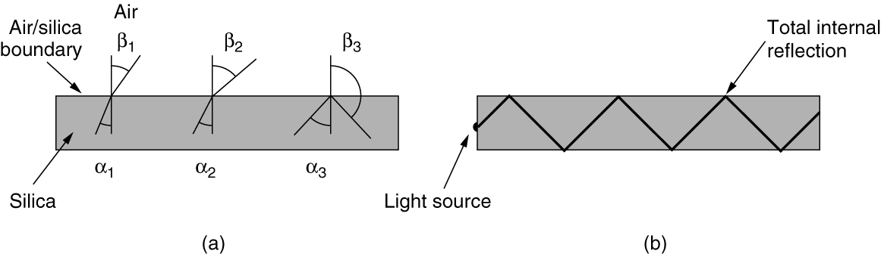
Fiber Optics (2 of 7)
Figure (a) illustrates a light ray inside a silica fiber impinging on the air/silica boundary at different angles. Figure (b) illustrates light trapped by total internal reflection.

Slide 9
Fiber Optics (3 of 7)
Transmission of light through fiber
Attenuation of light through glass
Dependent on the wavelength of the light
Defined as the ratio of input to output signal power
Fiber cables
Similar to coax, except without the braid
Two kinds of signaling light sources
LEDs (Light Emitting Diodes)
Semiconductor lasers

Slide 10
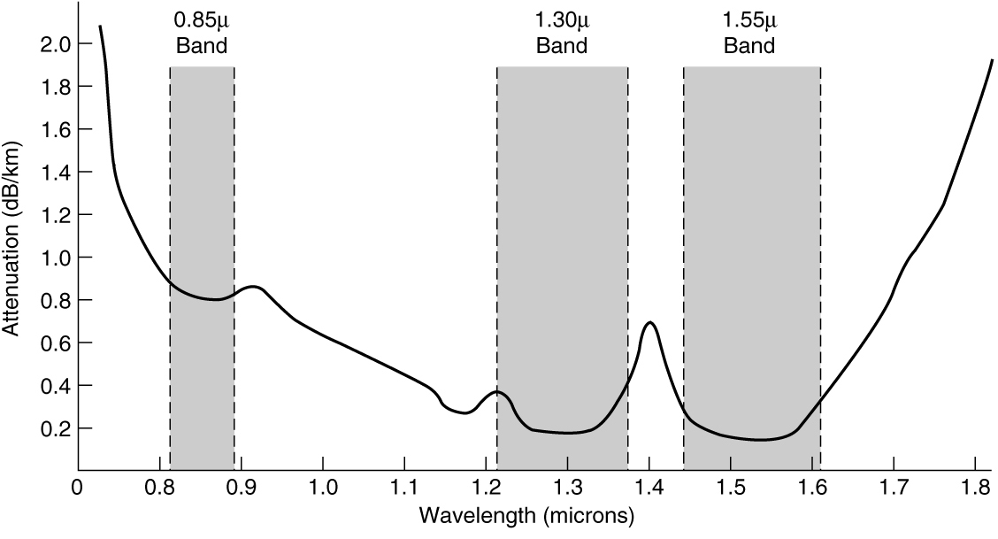
Fiber Optics (4 of 7)
Attenuation of light through fiber in the infrared region is measured in units of decibels (dB) per linear kilometer of fiber.

Slide 11
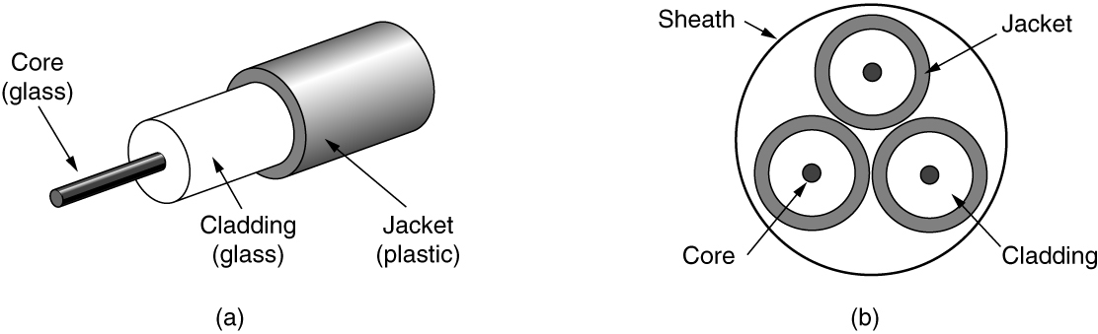
Fiber Optics (5 of 7)
Views of a fiber cable

Slide 12
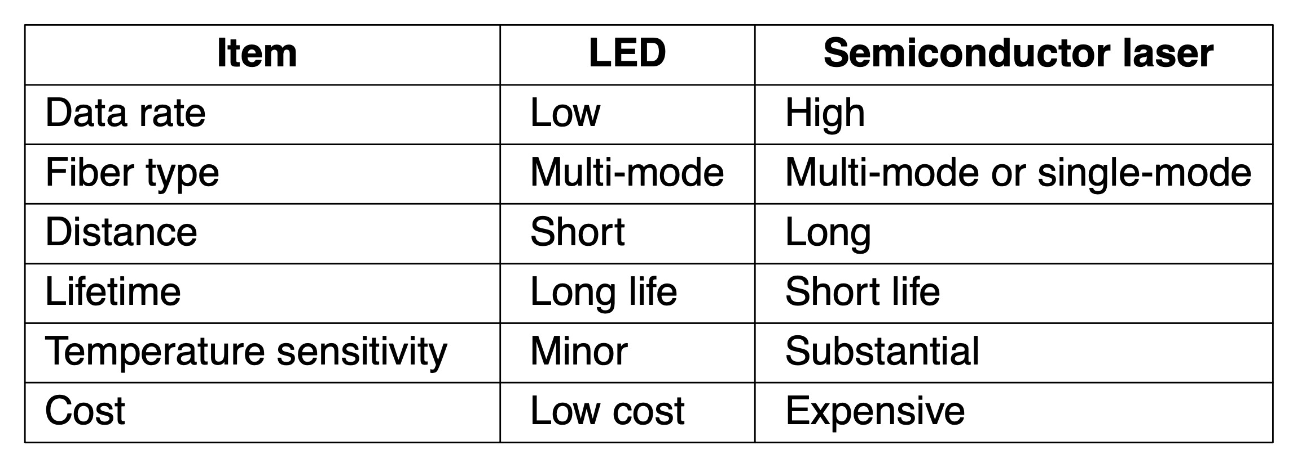
Fiber Optics (6 of 7)
A comparison of semiconductor diodes and LEDs as light sources.

Slide 13
Fiber Optics (7 of 7)
Fiber advantages over copper
Handles higher bandwidth
Not affected by power surges, electromagnetic interference, power failures, corrosive chemicals
Thin and lightweight
Do not leak light
Difficult to tap
Fiber disadvantage
Less familiar technology that requires specific engineering skills
Fibers damaged easily by being bent too much

Slide 14
Wireless Transmission
The electromagnetic spectrum
Modulate wave amplitude, frequency, or phase
Frequency hopping spread spectrum
Transmitter hops from frequency to frequency hundreds of times per second
Direct sequence spread spectrum
Code sequence spreads data signal over wider frequency band
Ultra-wideband communication
Communication sends a series of low-energy rapid pulses, varying their carrier frequencies to communicate information

Slide 15
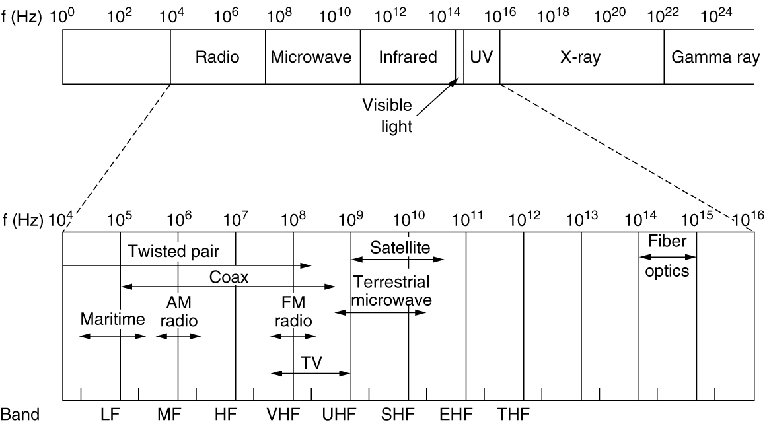
The Electromagnetic Spectrum
The electromagnetic spectrum and its uses for communication.

Slide 16
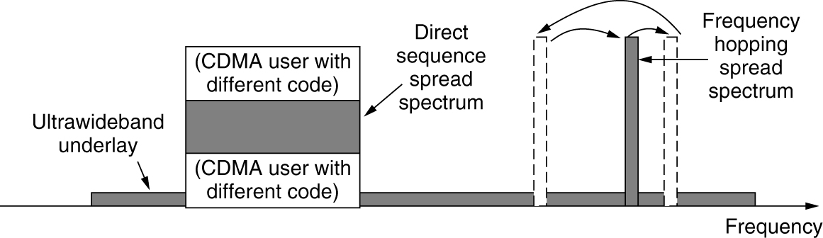
Direct Sequence Spread Spectrum
Direct sequence spread spectrum uses a code sequence to spread the data signal over a wider frequency band.

Slide 17
Using the Spectrum for Transmission
Radio transmission
Omnidirectional waves, easy to generate, travel long distances, penetrate buildings
Microwave transmission
Directional waves requiring repeaters, do not penetrate buildings
Infrared transmission
Unguided waves used for short-range communication, relatively directional, cheap, easy to build, do not penetrate solid walls
Light transmission
Unguided optical communication

Slide 18
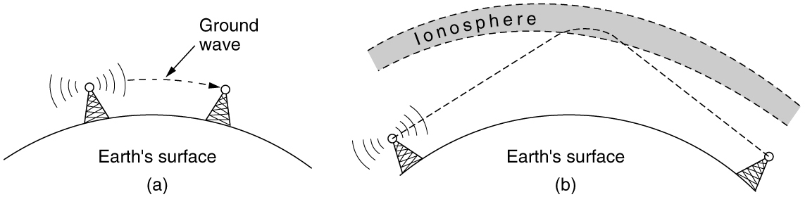
Radio Transmission
In the VLF, LF, and MF bands, radio waves follow the curvature of the earth. In the HF band, they bounce off the ionosphere.

Slide 19
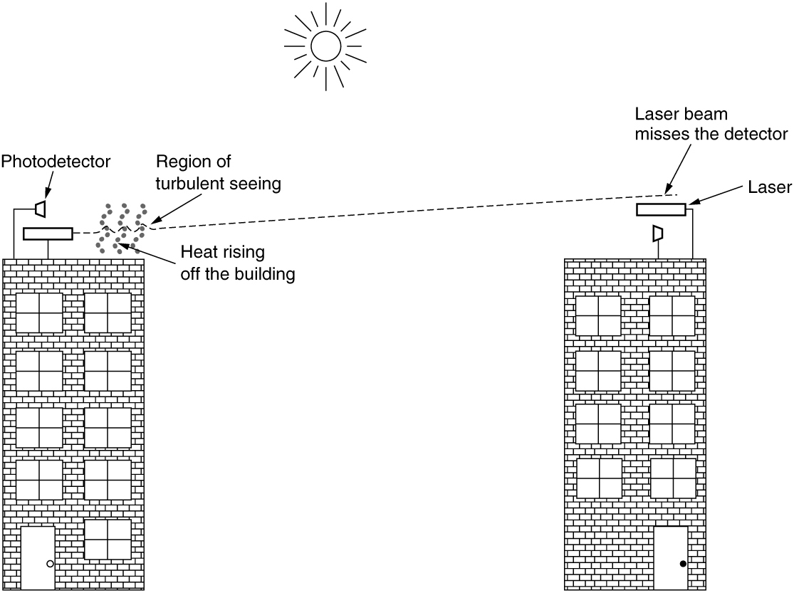
Light Transmission
Convection currents can interfere with laser communication systems. A bidirectional system with two lasers is pictured here.

Slide 20
From Waveforms to Bits
The theoretical basis for data communication
Fourier analysis
Bandwidth-limited signals
Digital modulation
Multiplexing

Slide 21
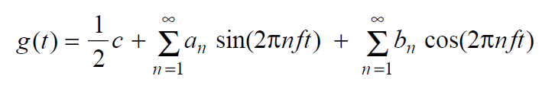
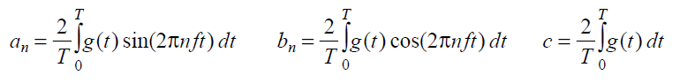
Fourier Analysis
We model the behavior of variation of voltage or current with mathematical functions
Fourier series is used
Function reconstructed with

Slide 22
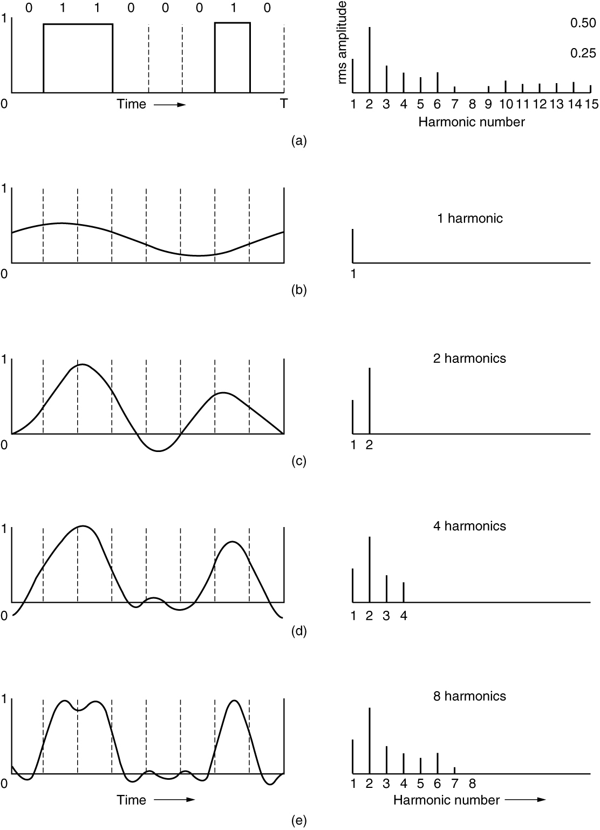
Bandwidth-Limited Signals (1 of 2)
A binary signal and its root-mean-square Fourier amplitudes. This is followed by successive approximations to the original signal.

Slide 23
Digital Modulation
Baseband transmission
Bandwidth efficiency
Balanced signals
Passband transmission

Slide 24
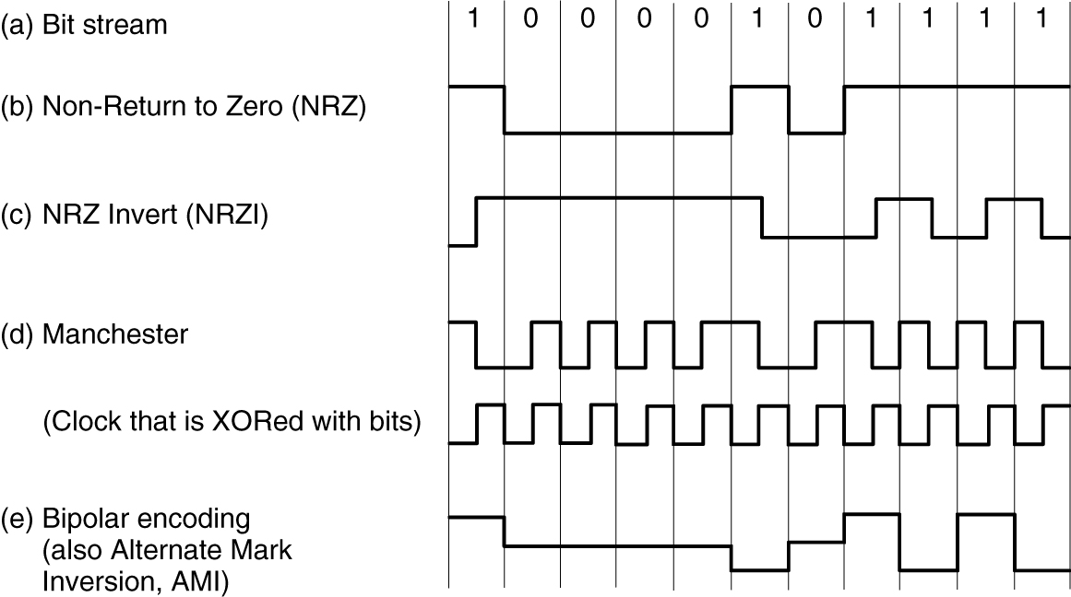
Baseband Transmission
Line codes: (a) Bits, (b) NRZ, (c) NRZI, (d) Manchester, (e) Bipolar or AMI.

Slide 25
Bandwidth
Bandwidth means different things to electrical engineers and to computer scientists.
To electrical engineers, (analog) bandwidth is a quantity measured in Hz. The hertz is equivalent to one cycle per second.
To computer scientists, (digital) bandwidth is the maximum data rate of a channel, a quantity measured in bits/sec.
That data rate is the end result of using the analog bandwidth of a physical channel for digital transmission, and the two are related.

Slide 26
Bandwidth Efficiency
Bandwidth is often a limited resource
Solution
Use more than two signaling levels
By using four voltages we can send 2 bits at once as a single symbol
Design works as long as the signal at the receiver is sufficiently strong to distinguish the four levels
Signal rate change is half the bit rate, so the needed bandwidth has been reduced

Slide 27
Balanced Signals
Balanced signals
Signals having as much positive voltage as negative voltage even over short periods of time
They average to zero (they have no DC electrical component)
Balancing helps to provide transitions for clock recovery
Provides a simple way to calibrate receivers
Straightforward way to construct a balanced code
Use two voltage levels to represent a logical 1 and a logical zero

Slide 28
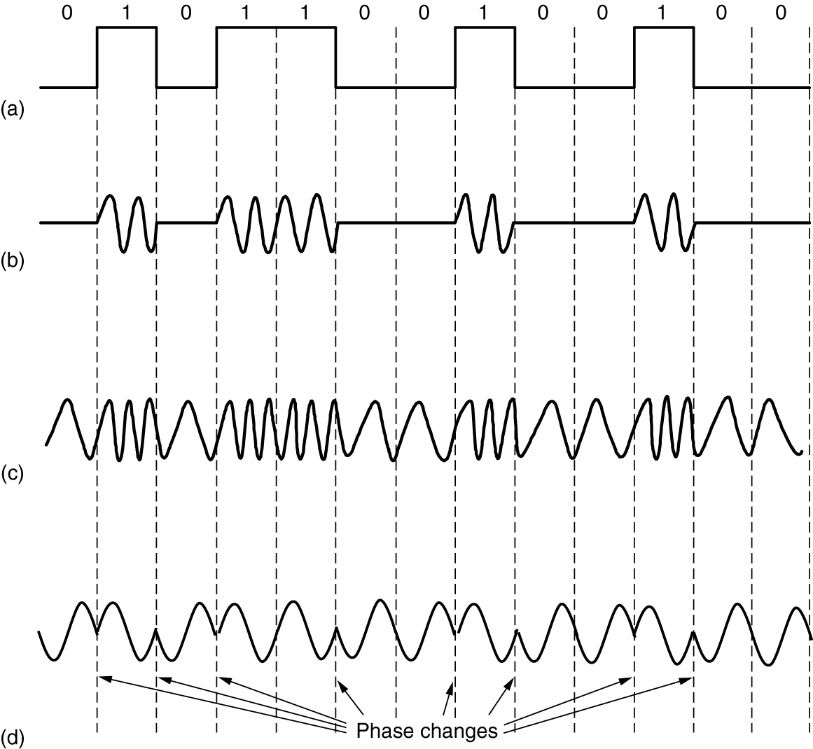
Passband Transmission (1 of 3)
(a) A binary signal. (b) Amplitude shift keying. (c) Frequency shift keying. (d) Phase shift keying.

Slide 29
Multiplexing
Frequency Division Multiplexing
Time Division Multiplexing
Code Division Multiplexing
Wavelength Division Multiplexing

Slide 30
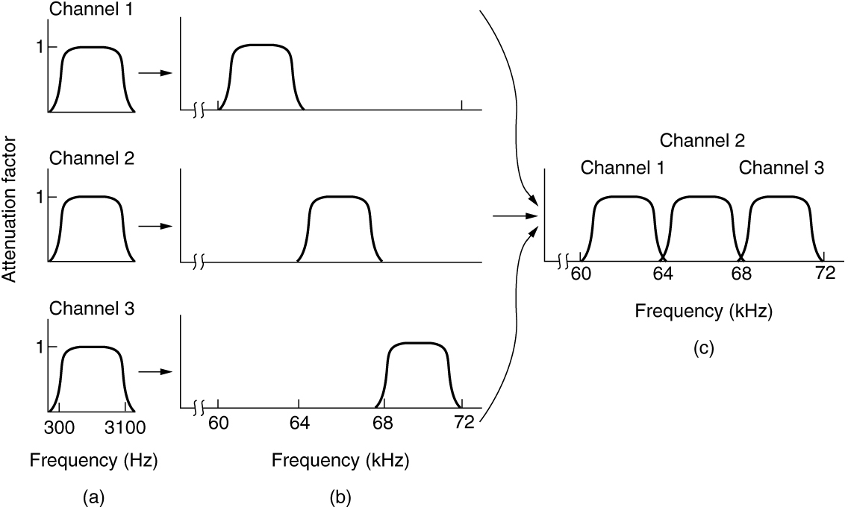
Frequency Division Multiplexing (1 of 2)
(a) The original bandwidths. (b) The bandwidths raised in frequency. (c) The multiplexed channel.

Slide 31
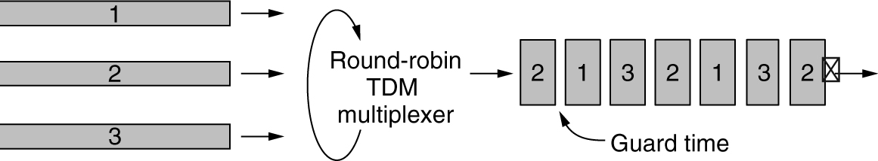
Time Division Multiplexing
Time Division Multiplexing (TDM)

Slide 32
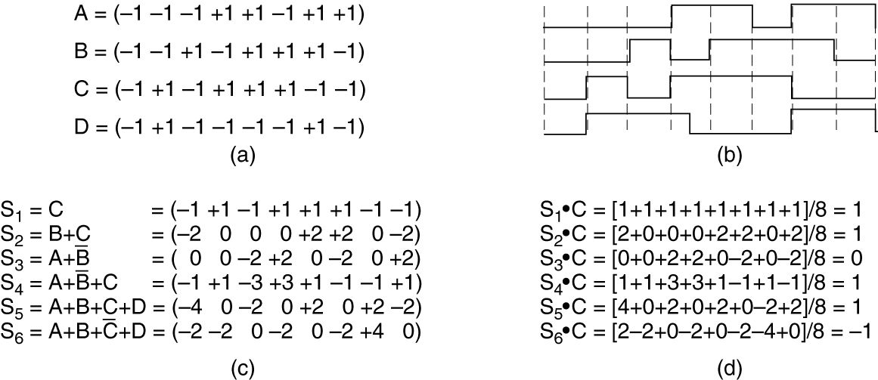
Code Division Multiplexing
(a) Chip sequences for four stations. (b) Signals the sequences represent. (c) Six examples of transmissions. (d) Recovery of station C’s signal.

Slide 33
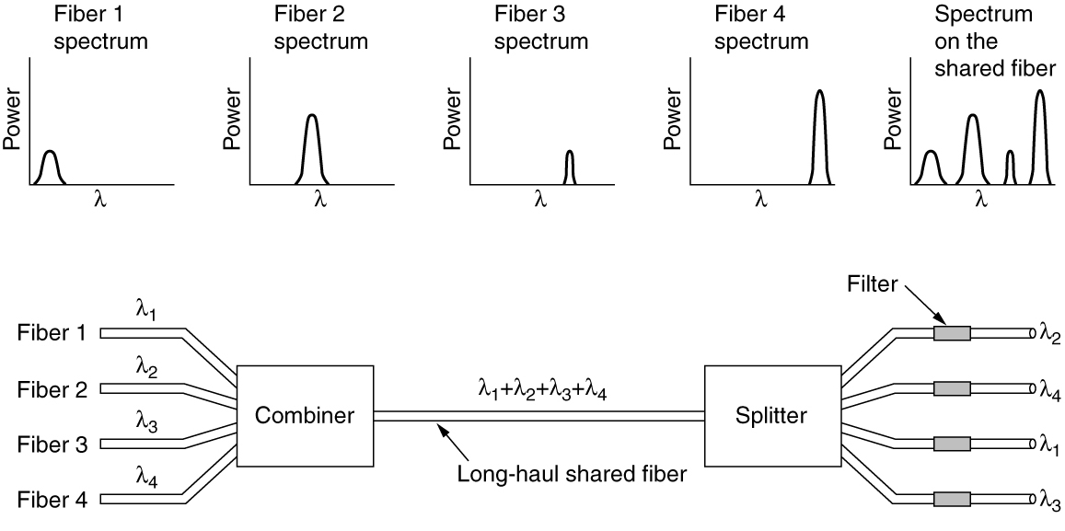
Wavelength Division Multiplexing
Wavelength division multiplexing

Slide 34
The Public Switched Telephone Network
Structure of the Telephone System
The Local Loop: Telephone Modems, ADSL, and Fiber
Telephone modems

Slide 35
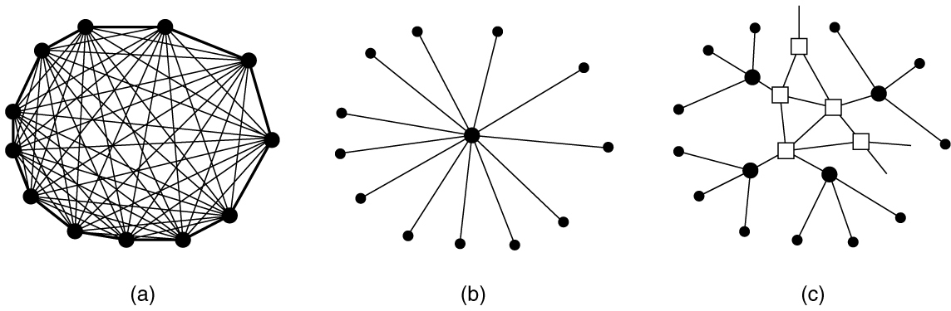
Structure of the Telephone System (1 of 2)
(a) Fully interconnected network. (b) Centralized switch. (c) Two-level hierarchy.

Slide 36
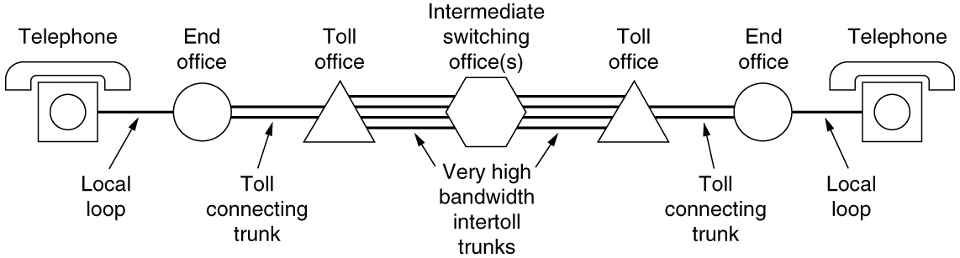
Structure of the Telephone System (2 of 2)
A typical circuit route for a long-distance call.

Slide 37
Telephone System Components
Local loops (analog twisted pairs between end offices and local houses and businesses).
Trunks (very high-bandwidth digital fiber-optic links connecting the switching offices).
Switching offices (where calls are moved from one trunk to another either electrically or optically).

Slide 38
The Local Loop: Telephone Modems, ADSL, and Fiber
Telephone Modems
Digital Subscriber Lines (DSL)
Fiber To The X (FTTX)

Slide 39
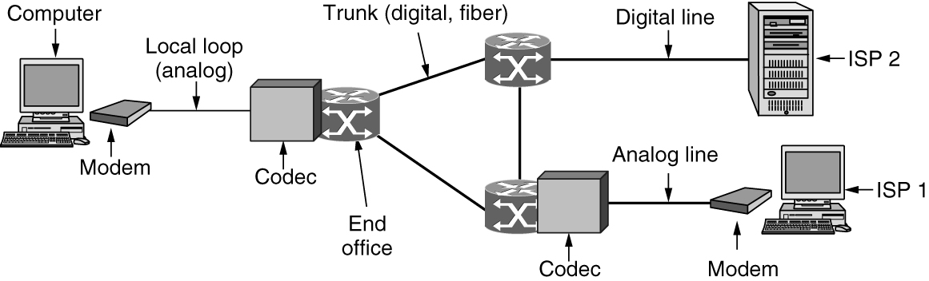
Telephone Modems (1 of 2)
A device that converts between a stream of digital bits and an analog signal that represents the bits is called a modem.
The use of both analog and digital transmission for a computer-to-computer call. Conversion is done by the modems and codecs.

Slide 40
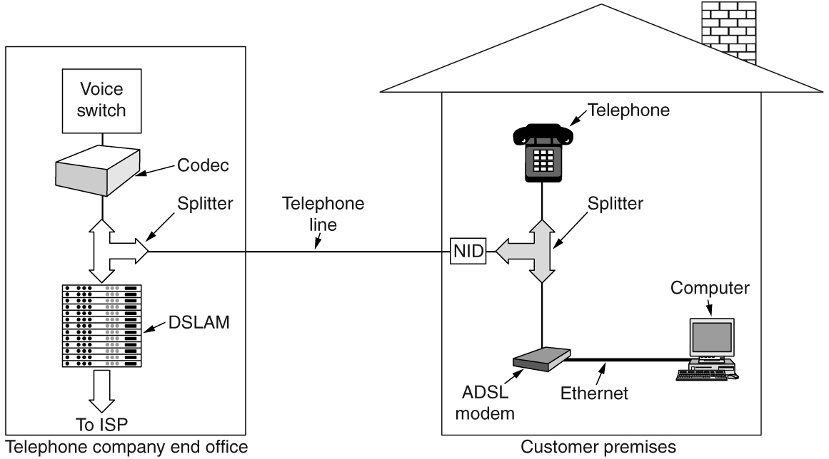
Digital Subscriber Lines (DSL) (3 of 3)
A typical ADSL equipment configuration.

Slide 41
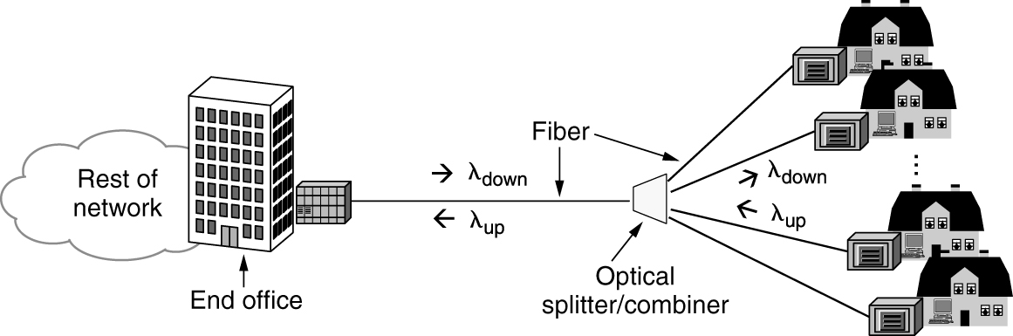
Fiber To The X (FTTX)
Passive optical network for Fiber To The Home.

Slide 42
Switching
Phone system principal parts
Outside plant (outside switching offices)
Inside plant (inside switching offices)
Two different switching techniques
Circuit switching: traditional telephone system
Packet switching: voice over IP technology

Slide 43
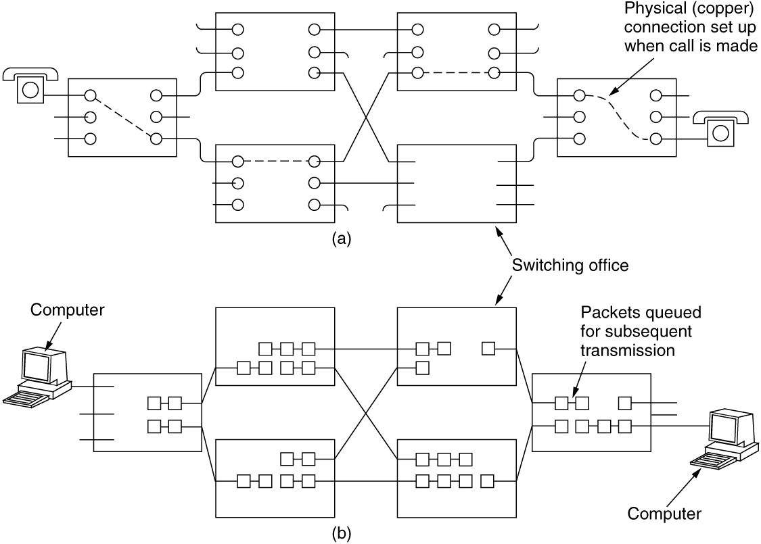
Circuit Switching (1 of 2)
(a) Circuit switching. (b) Packet switching.

Slide 44
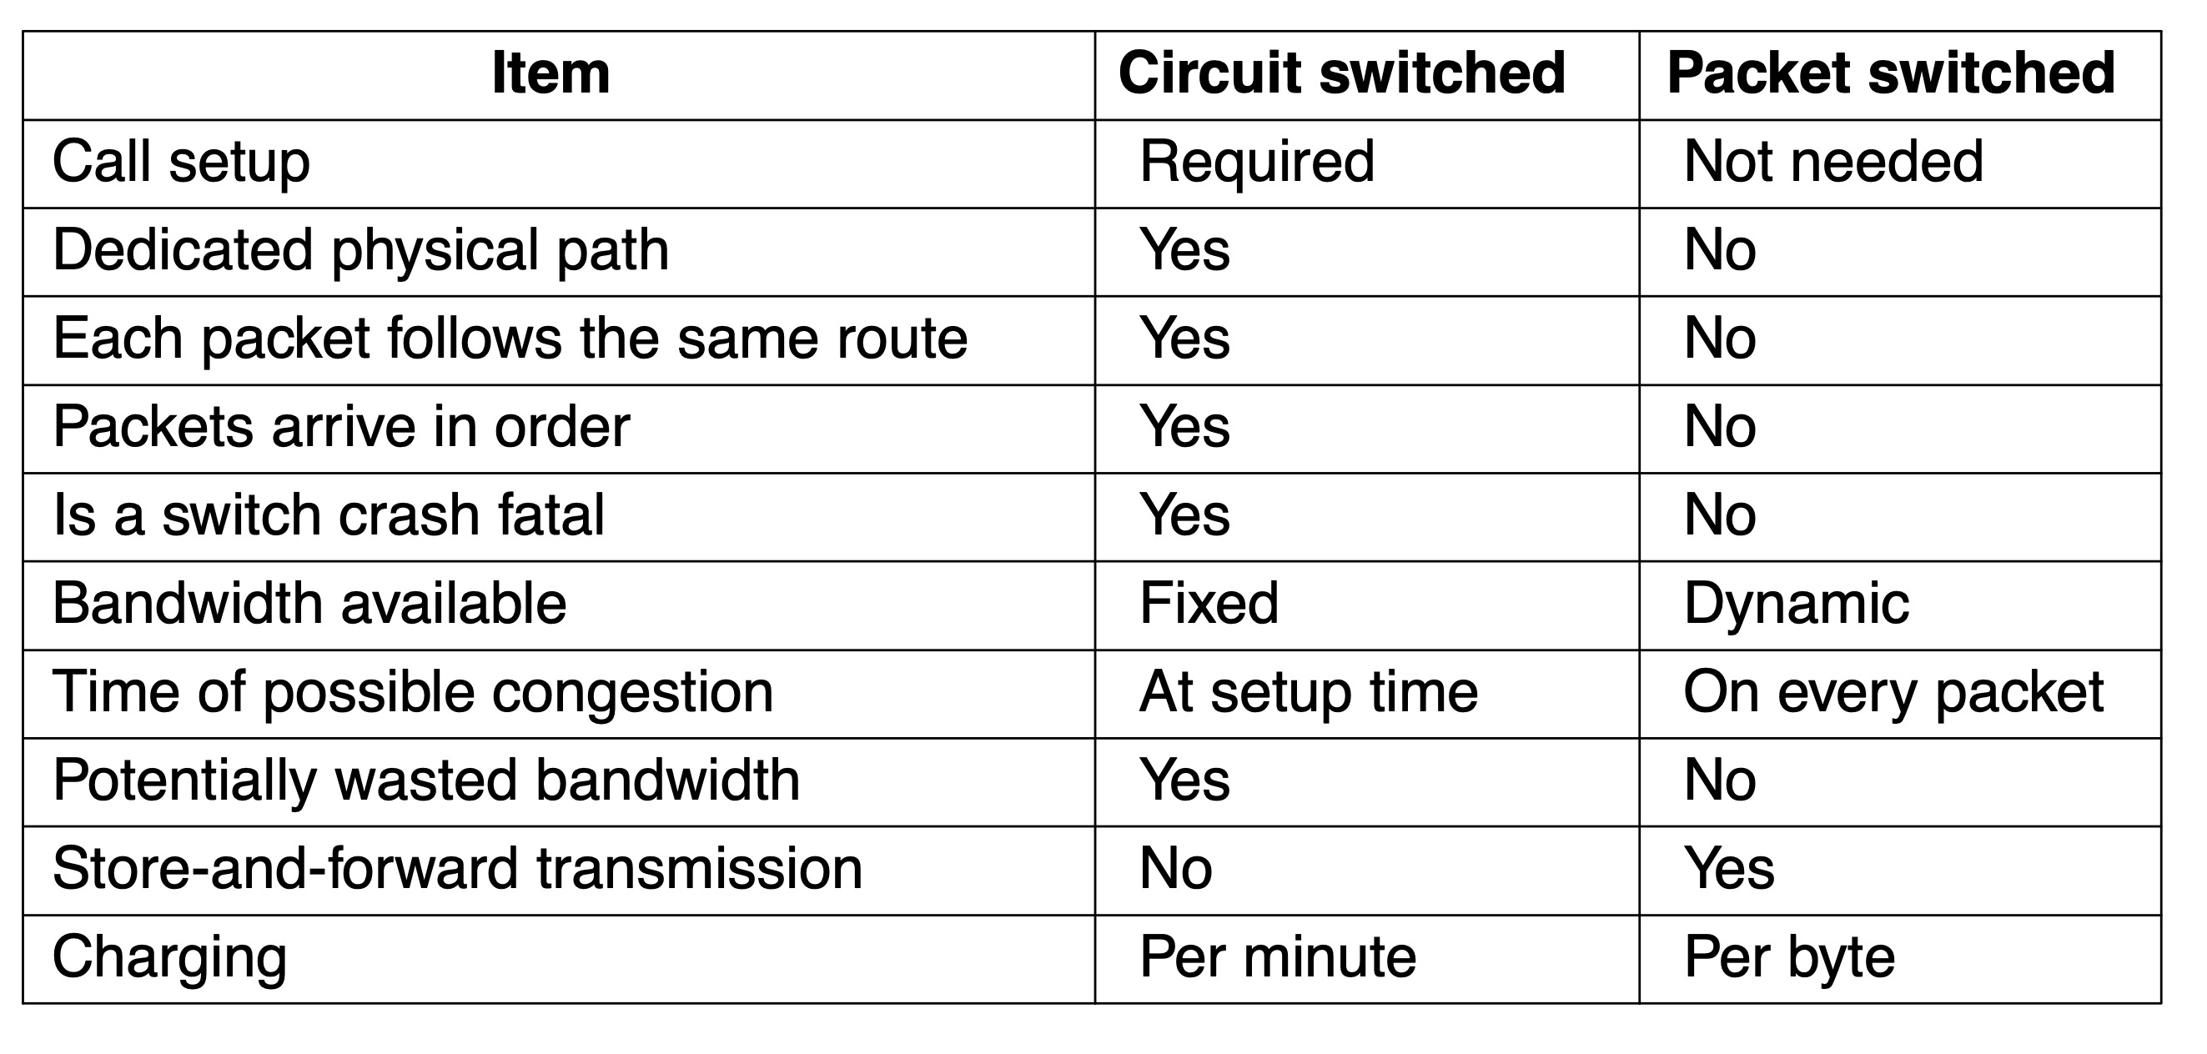
Packet Switching
A comparison of circuit-switched and packet-switched networks.

Slide 45
Questions for you
Difference between Baseband and Passband Transmission?
How FDM works?
How TDM works?
How CDM works?
How WDM works?

Slide 46
Cellular Networks
Mobile phone distinct generations
The initial three generations: 1G, 2G, 3G
Provided analog voice, digital voice, and both digital voice and data (Internet, email, etc.) respectively
4G technology adds capabilities
Physical layer transmission techniques and IP-based femtocells
4G is based on packet switching only (no circuit switching)
5G being rolled out now
Supports up to 20 Gbps transmissions and denser deployments
Focus on reducing network latency

Slide 47
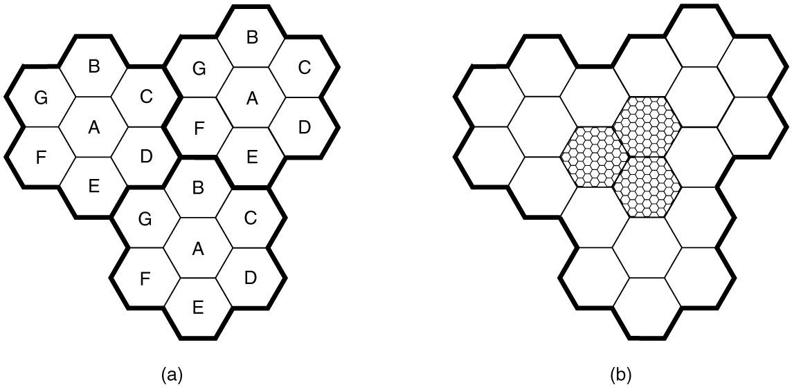
Common Concepts: Cells
A geographic region is divided up into cells, allow for frequency reuse
(a) Frequencies are not reused in adjacent cells. (b) To add more users, smaller cells can be used.

Slide 48
Common Concepts: Cells
At the center of each cell is a base station to which all the telephones in the cell transmit.
The base station consists of a computer and transmitter/receiver connected to an antenna.
In a small system, all the base stations are connected to a single device called an MSC (Mobile Switching Center) or MTSO (Mobile Telephone Switching Office).
In a larger one, several MSCs may be needed, all of which are connected to a second-level MSC, and so on.

Slide 49
First-Generation (1G) Technology: Analog Voice
1946 push to talk systems
1960 IMTS (Improved Mobile Telephone System)
Two frequencies: one for sending, one for receiving
1983 AMPS (Advanced Mobile Phone System)
Analog mobile phone system
Cells are typically 10 to 20 km across
Used FDM to separate channels

Slide 50
Call Management
Outgoing calls
Phone switched on, number entered, CALL button hit
Phone transmits called number and its own identity on the access channel
Base informs the MSC and MSC looks for a channel for the call
Incoming calls
Idle phones continuously listen to the paging channel to detect messages directed at them
Packet sent to base station in the current cell as a broadcast on the paging channel
The called phone responds on the access channel
Called phone switches to channel and starts ringing sound

Slide 51
Second-Generation (2G) Technology: Digital Voice
Digital advantages
Provides capacity gains by allowing voice signals to be digitized and compressed
Improves security by allowing voice and control signals to be encrypted
Deters fraud and eavesdropping
Enables new services such as text messaging
Three systems developed
D-AMPS (Digital Advanced Mobile Phone System)
GSM (Global System for Mobile communications)
CDMA (Code Division Multiple Access)

Slide 52
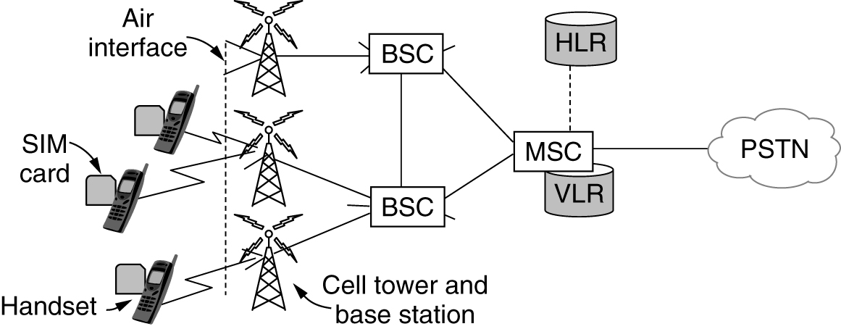
GSM: The Global System for Mobile Communications (1 of 3)
GSM mobile network architecture.

Slide 53
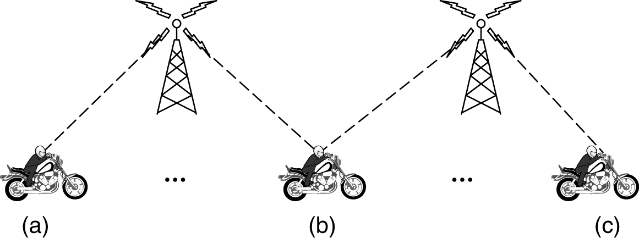
Third-Generation (3G) Technology: Digital Voice and Data
Soft handoff (a) before, (b) during, and (c) after.

Slide 54
Fourth-Generation (4G) Technology: Packet Switching
Also called IMT Advanced
Based completely on packet-switched technology
EPC (Evolved Packet Core) allows packet switching
Carries both voice and data in IP packets
Voice over IP (VoIP) network with resources allocated using the statistical multiplexing approaches
The EPC must manage resources in such a way that voice quality remains high in the face of network resources that are shared among many users

Slide 55
Fifth-Generation (5G) Technology
Two main factors
Higher data rates and lower latency than 4G technologies
Technology used to increase network capacity
Ultra-densification and offloading
Increased bandwidth
Increased spectral efficiency through advances in massive MIMO (Multiple-Input Multiple-Output) technology
Network slicing feature
Lets cellular carriers create multiple virtual networks on top of the same shared physical infrastructure
Can devote network portions to specific customer use cases

Slide 56
Cable Networks
Cable networks
Will factor heavily into future broadband access networks
Many people nowadays get their television, telephone, and Internet service over cable
2018 DOCSIS standard
Provides information related to modern cable network architectures

Slide 57
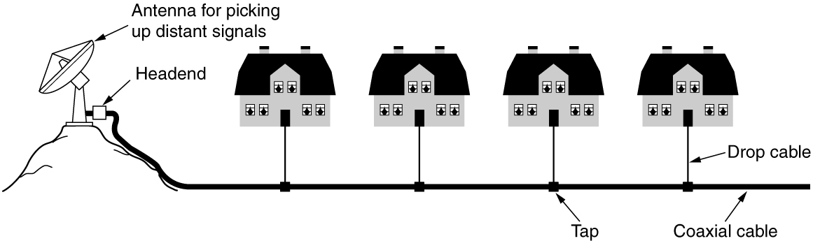
A History of Cable Networks: Community Antenna Television
An early cable television system.

Slide 58
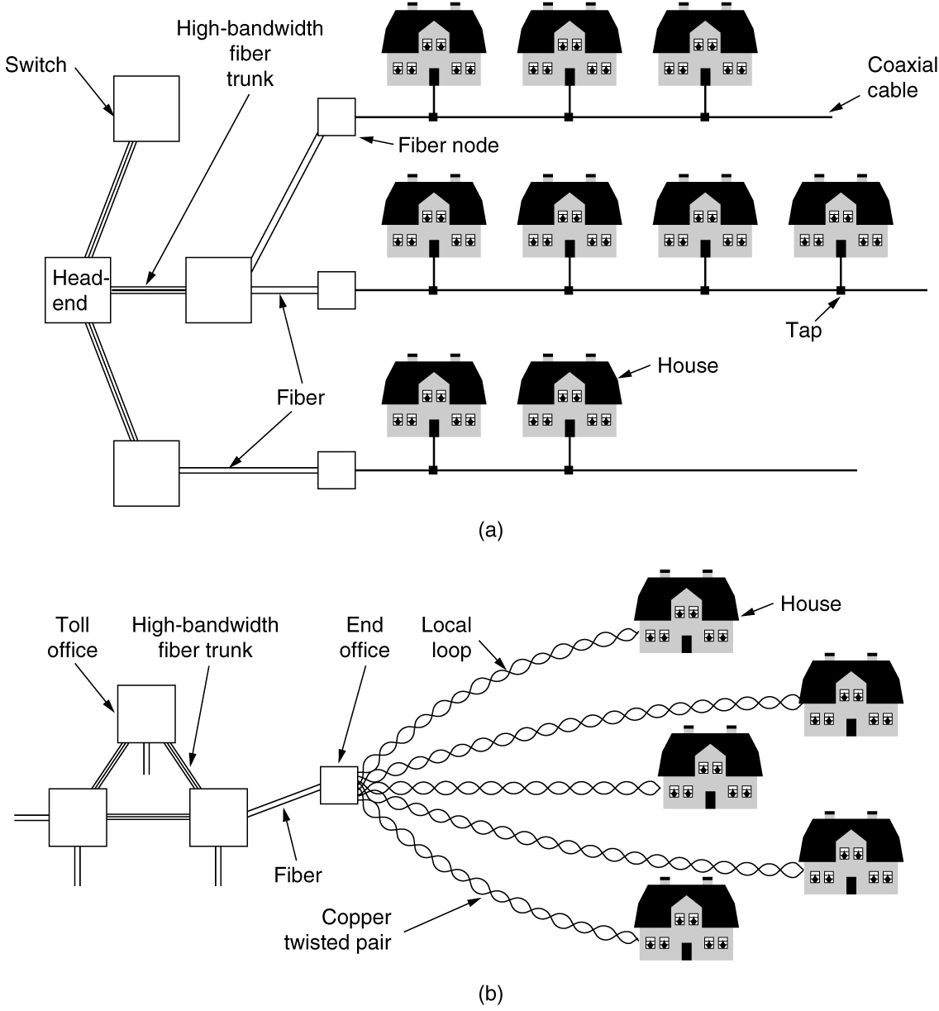
Broadband Internet Access Over Cable: HFC Networks (1 of 2)
(a) Hybrid Fiber-Coax cable network. (b) The fixed phone system.

Slide 59
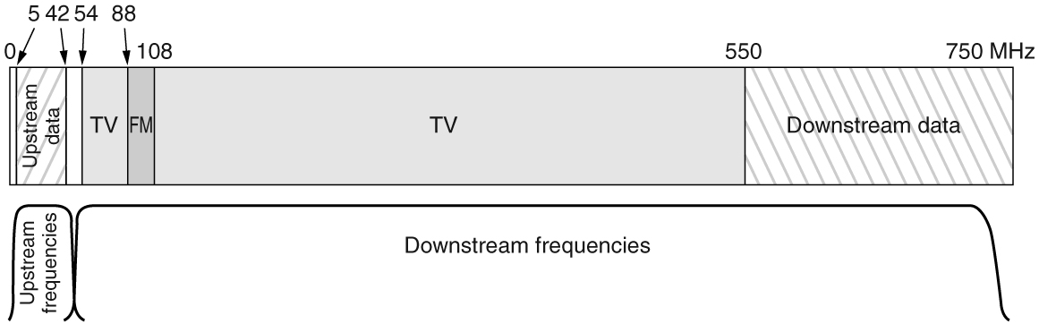
Broadband Internet Access Over Cable: HFC Networks (2 of 2)
Frequency allocation in a typical cable TV system used for Internet access.

Slide 60
DOCSIS
DOCSIS (Data Over Cable Service Interface Specification) 3.1 latest version
Introduced Orthogonal Frequency Division Multiplexing (OFDM)
Introduced wider channel bandwidth and higher efficiency
Enabled over 1 Gbps of downstream capacity per home
Extensions to DOCSIS 3.1
Full Duplex operation (2017) and DOCSIS Low Latency (2018)
Cable Internet subscribers require a DOCSIS cable modem
Modem-to-home network interface: Ethernet connection

Slide 61
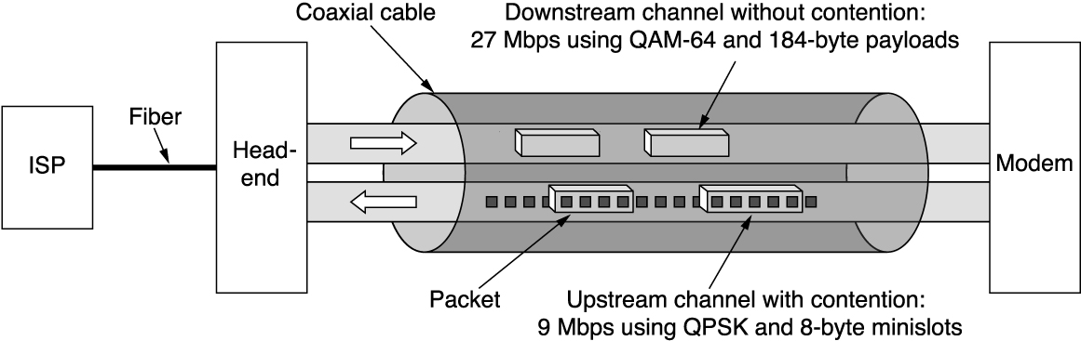
Resource Sharing in DOCSIS Networks
Typical details of the upstream and downstream channels in North America.

Slide 62
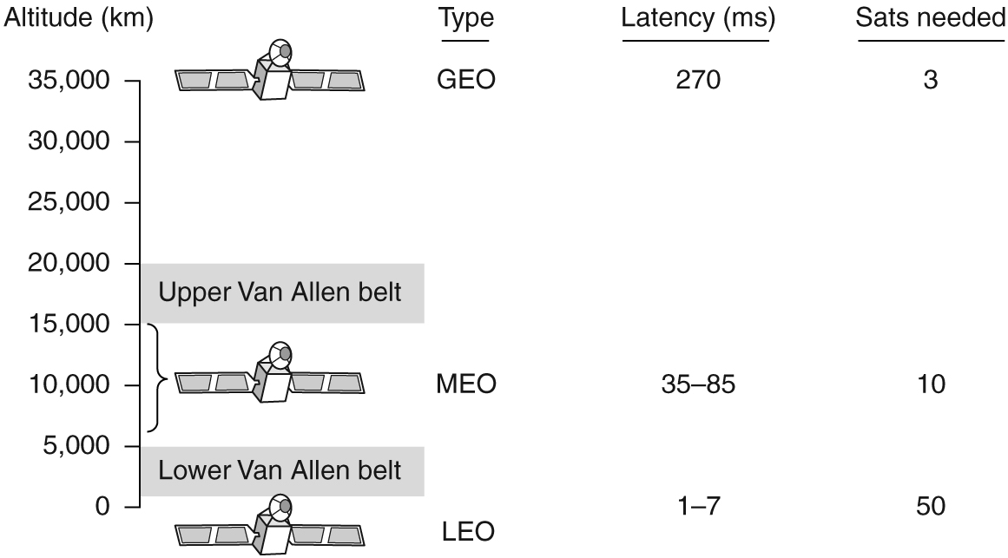
Communication Satellites
Communication satellites and some of their properties, including altitude above the earth, round-trip delay time, and number of satellites needed for global coverage.

Slide 63
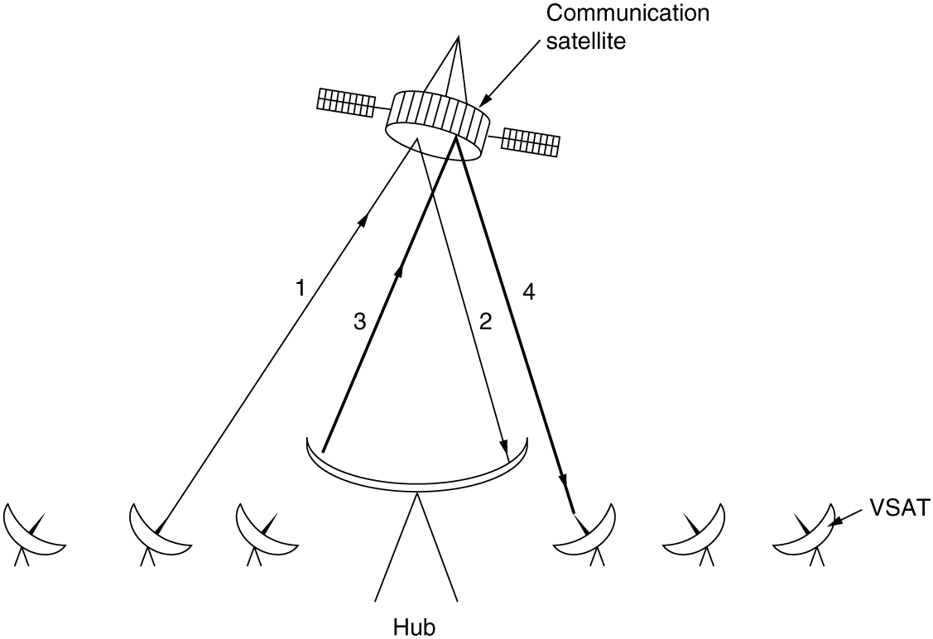
Geostationary Satellites (2 of 2)
Arthur Clarke thought about GEO
VSATs using a hub.

Slide 64
Medium-Earth Orbit Satellites
MEO (Medium-Earth Orbit) satellites
Found at lower altitudes - between the two Van Allen belts
Drift slowly in longitude (6 hours to circle the earth)
Must be tracked as they move through the sky
Have a smaller footprint on the ground
Require less powerful transmitters to reach them
Used for navigation systems

Slide 65
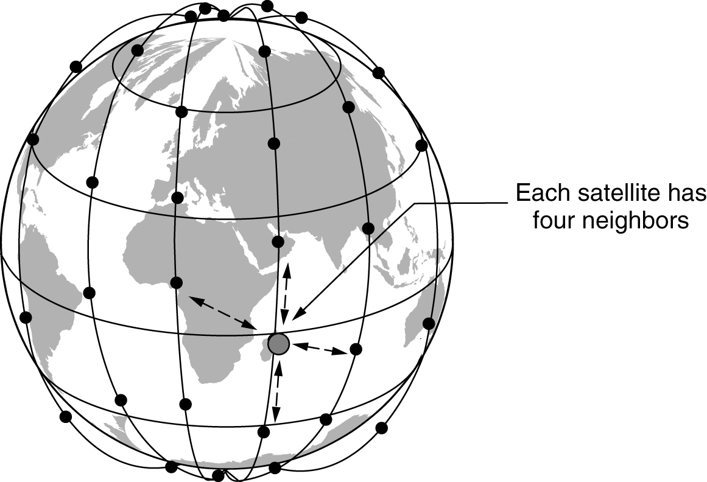
Low-Earth Orbit Satellites (1 of 2)
The Iridium satellites form six necklaces around the earth.

Slide 66
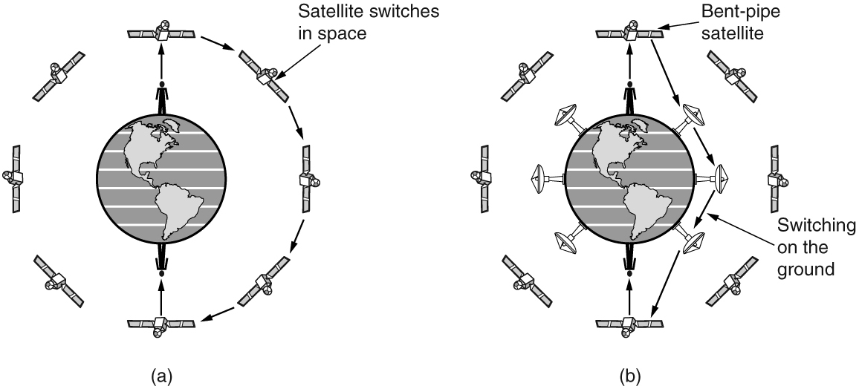
Low-Earth Orbit Satellites (2 of 2)
(a) Relaying in space. (b) Relaying on the ground.

Slide 67
Terrestrial Access Networks: Cable, Fiber, and ADSL
Similarities
Comparable service and comparable prices
Use fiber in the backbone
Differences
Last-mile access technology at the physical and link layers
Bandwidth consistency
Cable subscribers share the capacity of a single node
Maximum speeds
Availability
Security

Slide 68
Satellites Versus Terrestrial Networks
Communication satellites niche markets
Rapid deployments
Places where the terrestrial infrastructure is poorly developed
When broadcasting is essential
United States has some competing satellite-based Internet providers
Satellite Internet access seeing a growing interest
In-flight Internet access

Slide 69

Copyright
This work is protected by United States copyright laws and is provided solely for the use of instructors in teaching their courses and assessing student learning. Dissemination or sale of any part of this work (including on the World Wide Web) will destroy the integrity of the work and is not permitted. The work and materials from it should never be made available to students except by instructors using the accompanying text in their classes. All recipients of this work are expected to abide by these restrictions and to honor the intended pedagogical purposes and the needs of other instructors who rely on these materials.

